Slide 1
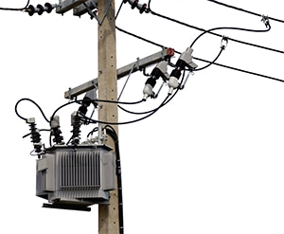
Transformer

Slide 2
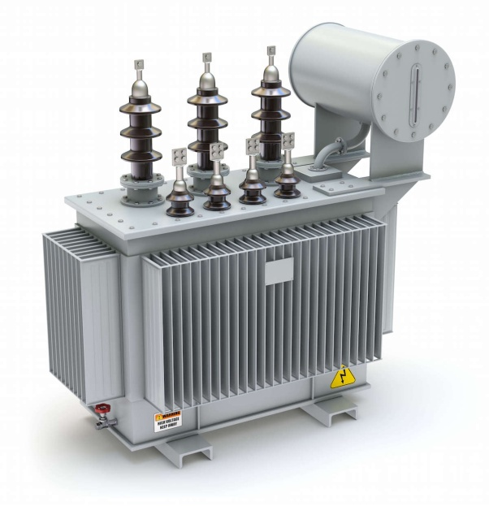
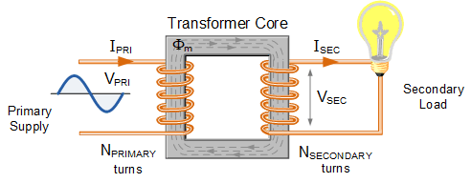
Transformer changes voltage
1 High-to-Low
2 Low-to-High

Slide 3
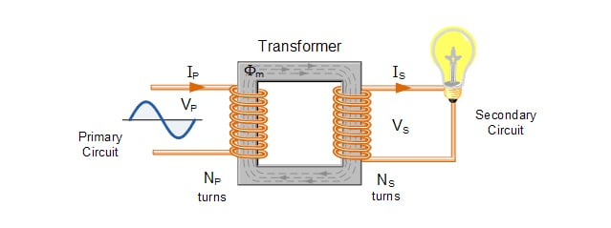
Main Parts of a Transformer
Primary coil
Secondary Coil
Iron Core

Slide 4
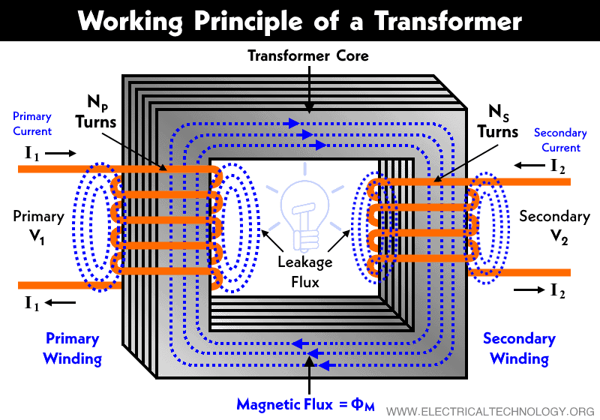
Working Principle
Electrical flux of Primary coil is linked to secondary coil through laminated soft iron core

Slide 5
Types of Transformers
Step down Transformer :
when the first coil (primary winding) has more turns than the second coil (secondary winding), so the secondary voltage is smaller than the primary voltage.
step-up transformer:
In This type the first coil has less turns than the second coil, causing the secondary voltage to be higher than the primary voltage.
Toroidal core
It uses toroid-shaped core material (ring or donut shaped), such as iron core or ferrite core. The ring shape makes the leakage inductance very low.
Air core transformer:
The flux linkage is made entirely using the air however, they produce low mutual inductance compared to a transformer with a physical core.

